Slide 1
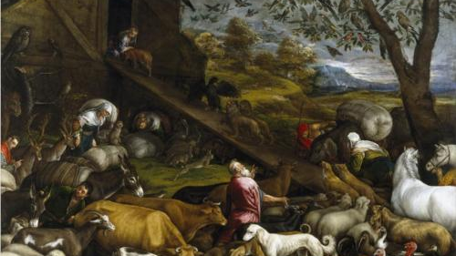
Genesis 8.1-9.17
Jacopo Bassano; wikiart.org

Slide 2
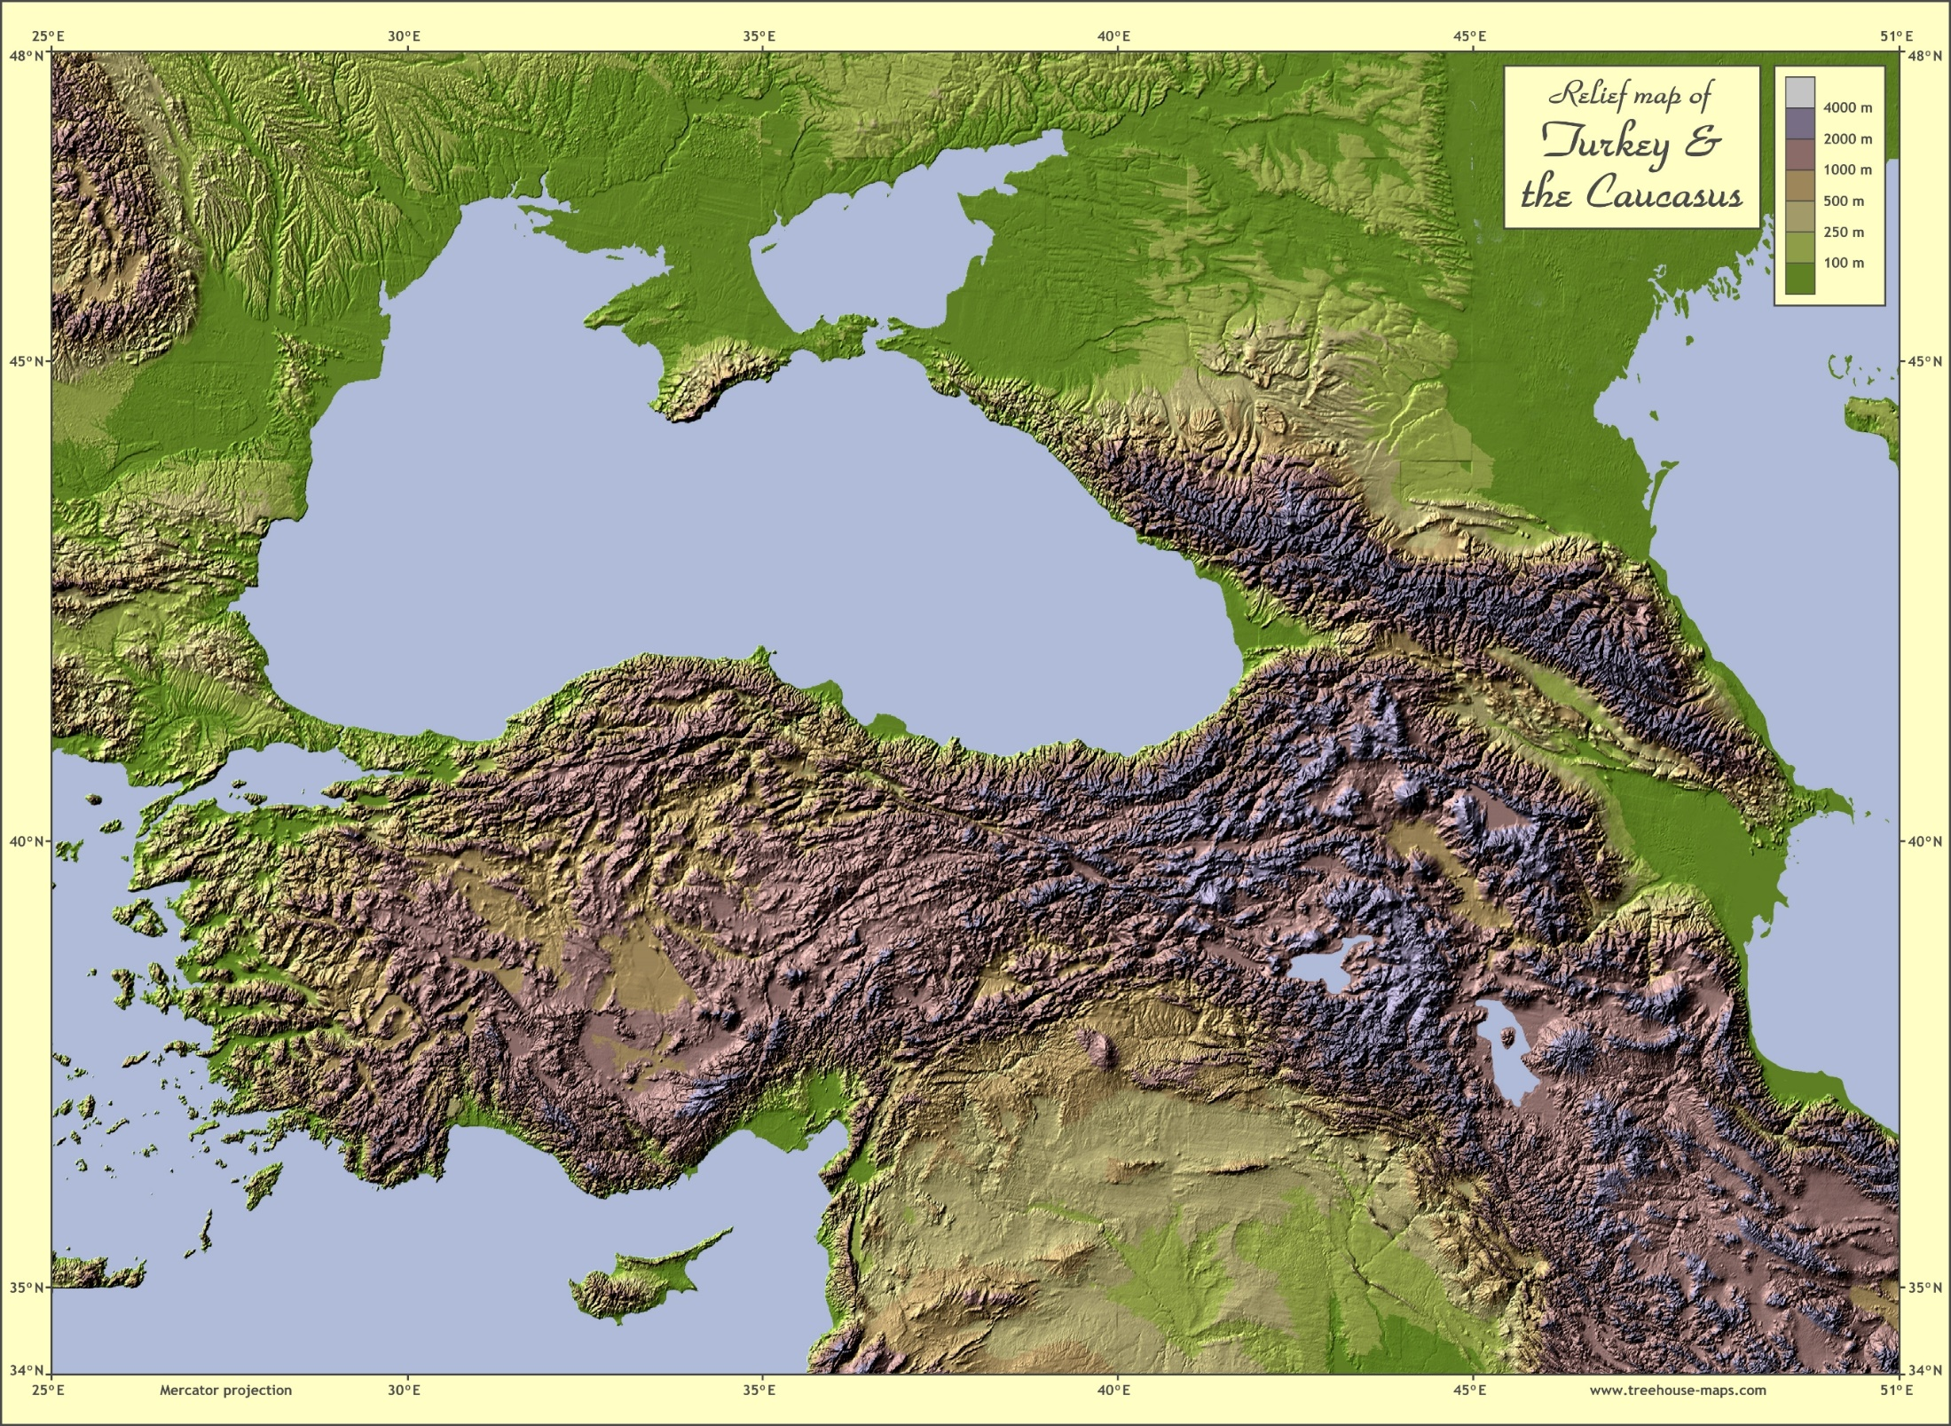
Ukraine
Russia
Romania
Bulgaria
Georgia
Azerbaijan
Armenia
Turkey
Iran
Syria
Iraq
treehouse-maps.com

Slide 3
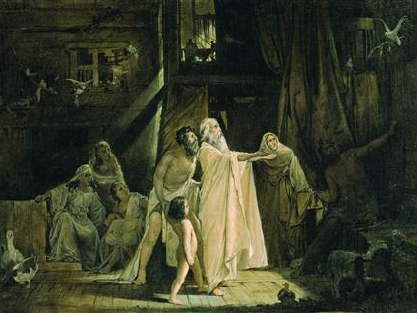
Andrei Ryabushkin; Russian Museum, St Petersburg, Russia; wikiart.org

Slide 4
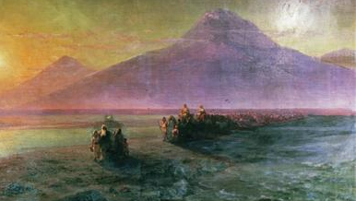
Ivan Arvazovsky; wikiart.org

Slide 5
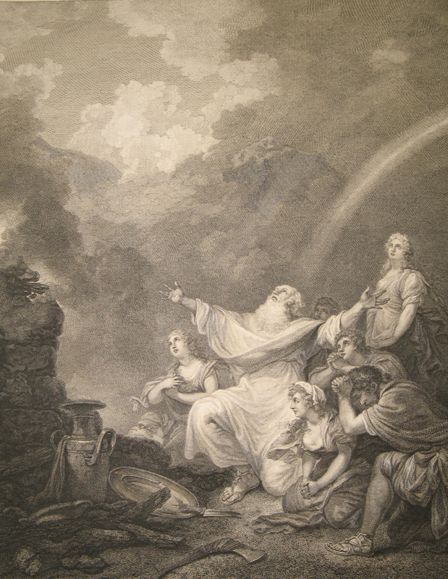
Philippe-Jacques de Loutherbourg & John Hall; Macklin Bible;
Jean and Alexander Heard Library;
Nashville; from Vanderbilt.edu

Slide 6
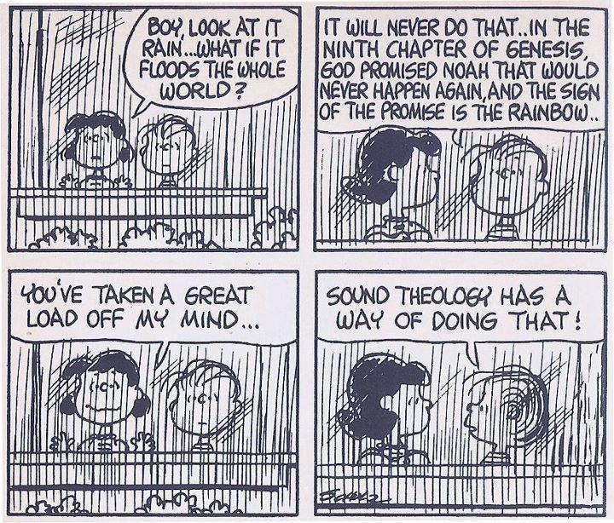
Charles Schulz

Slide 7
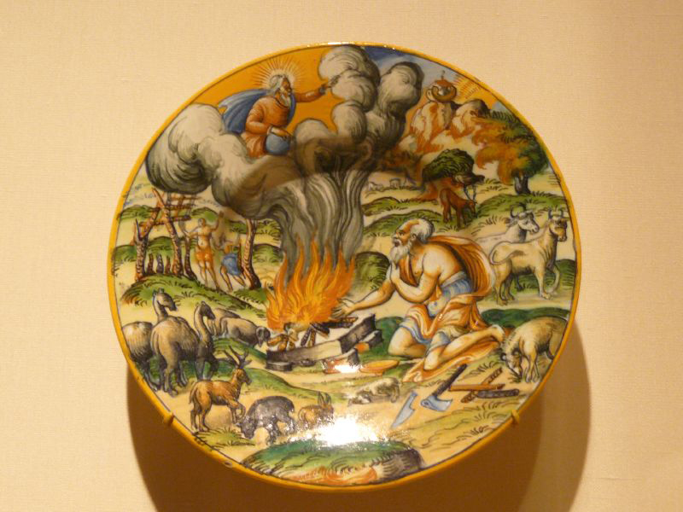

Slide 8
Leviticus 17.10-11 NET: “…I will set my face against that person who eats the blood, and I will cut him off from the midst of his people, for the life of every living thing is in the blood. So I myself have assigned it to you on the altar to make atonement for your lives, for the blood makes atonement by means of the life.”

Slide 9
Acts 15.19-20 NET: “I conclude that we should not cause extra difficulty for those among the Gentiles who are turning to God, but that we should write them a letter telling them to abstain from things defiled by idols and from sexual immorality and from what has been strangled and from blood.”

Slide 10
